Slide 1
CS419 Recitation Class
Topic：Cryptography
Notes:
/krɪpˈtɑːɡrəfi/

Slide 2
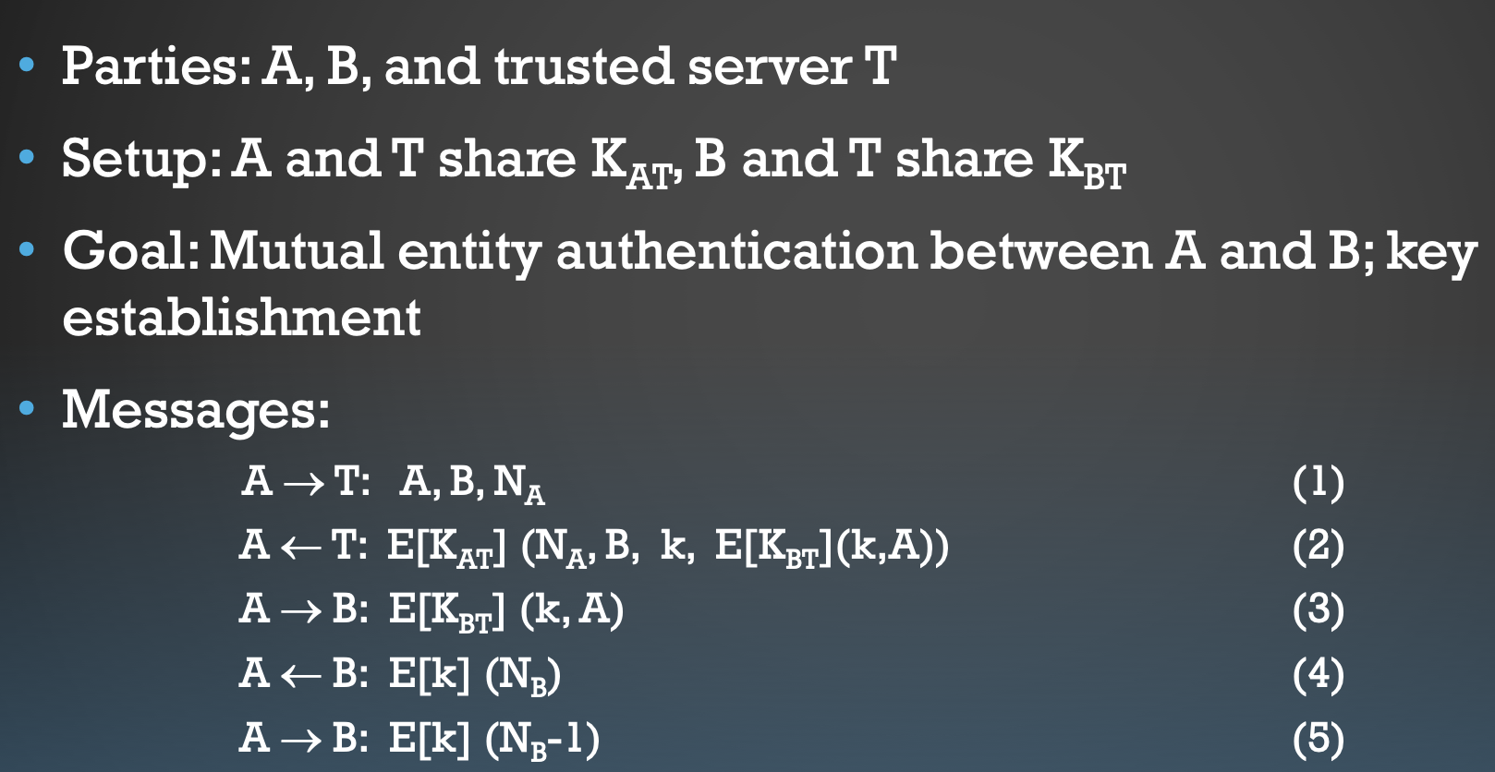
Needham-Schroeder Shared-key Protocol
For a group of N parties, every pair needs to share a different key
• What is the number of keys?
Solutions • Symmetric Encryption-Use a central authority
A and B are identities of Alice and Bob respectively
K_{AT} is a symmetric key known only to A and T
K_{BT} is a symmetric key known only to B and T
N_{A} and N_{B} are nonces generated by A and B respectively
k is a symmetric, generated key, which will be the session key of the session between A and B

Slide 3
Needham-Schroeder Shared-key Protocol
(1) Alice sends a message to the server identifying herself and Bob, telling the server she wants to communicate with Bob.
(2) The server generates k and sends back to Alice a copy encrypted under K_{BT} for Alice to forward to Bob and also a copy for Alice. Since Alice may be requesting keys for several different people, the nonce assures Alice that the message is fresh.
(3) Alice forwards the key to Bob who can decrypt it with the key he shares with the server, thus authenticating the data.
(4) Bob sends Alice a nonce encrypted under k to show that he has the key.
(5) Alice performs a simple operation on the nonce, re-encrypts it and sends it back verifying that she is still alive and that she holds the key
The protocol is vulnerable to a replay attack. If an attacker uses an older, compromised value for k, he can then replay the message E[K_{BT}](k, A) to Bob, who will accept it, being unable to tell that the key is not fresh.
This flaw is fixed in the Kerberos protocol by the inclusion of a timestamp.

Slide 4
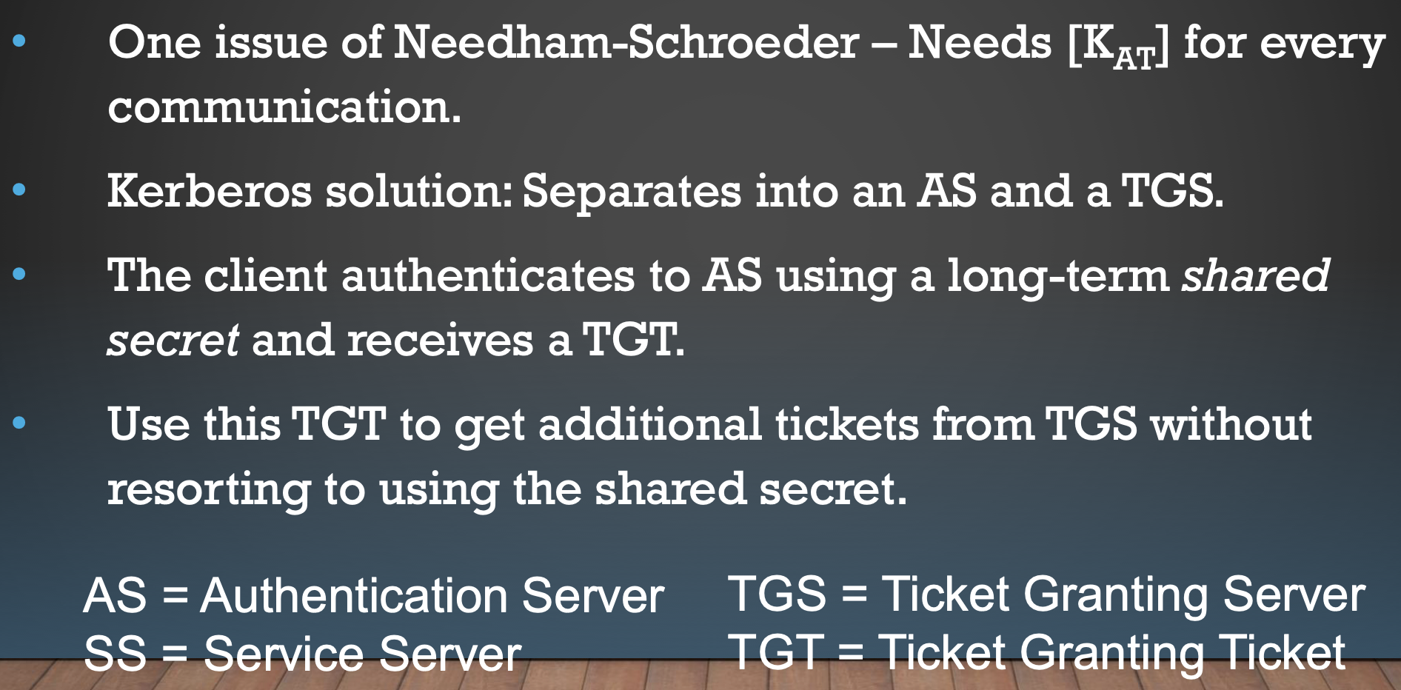
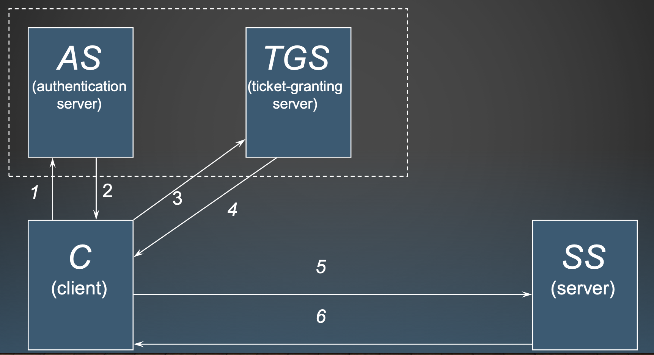
Kerberos Protocol
Kerberos is a network authentication protocol Provides authentication and secure communication

Slide 5
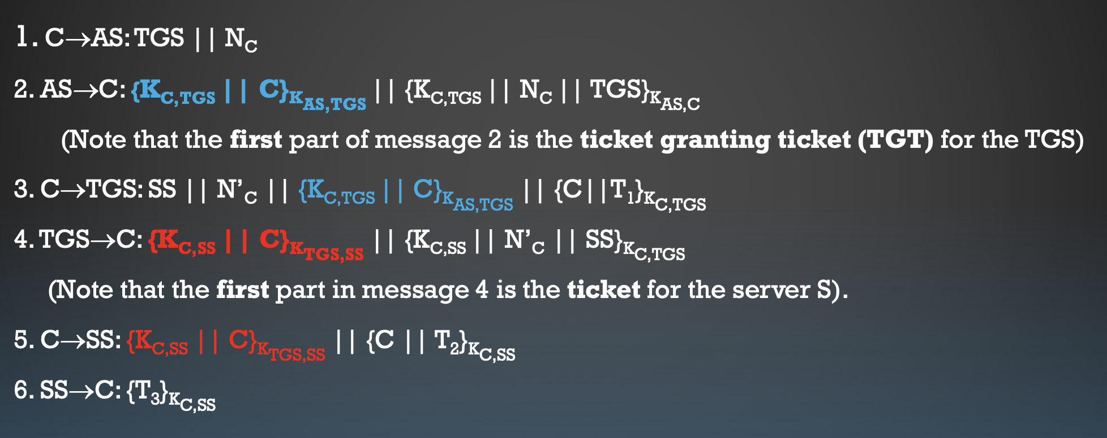
Kerberos Protocol
T: Authenticator, includes client ID and the timestamp
Defense replay attack

Slide 6
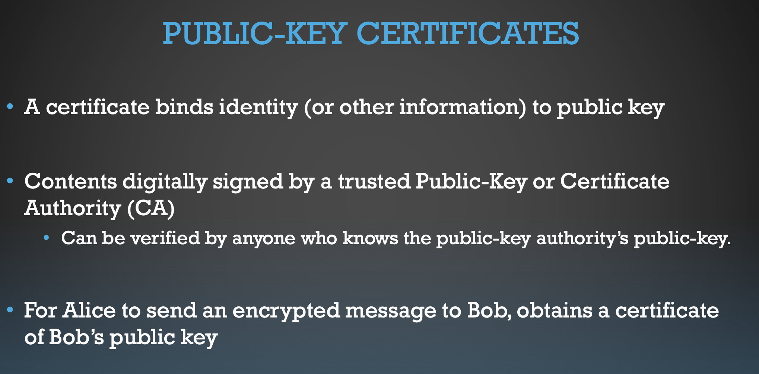
Kerberos Protocol

Slide 7
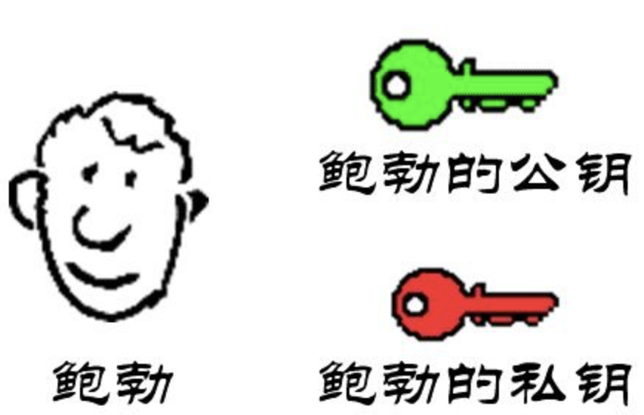
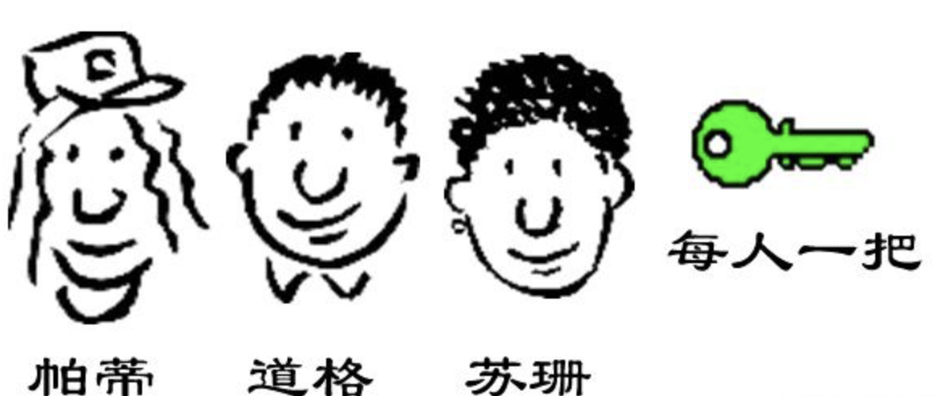
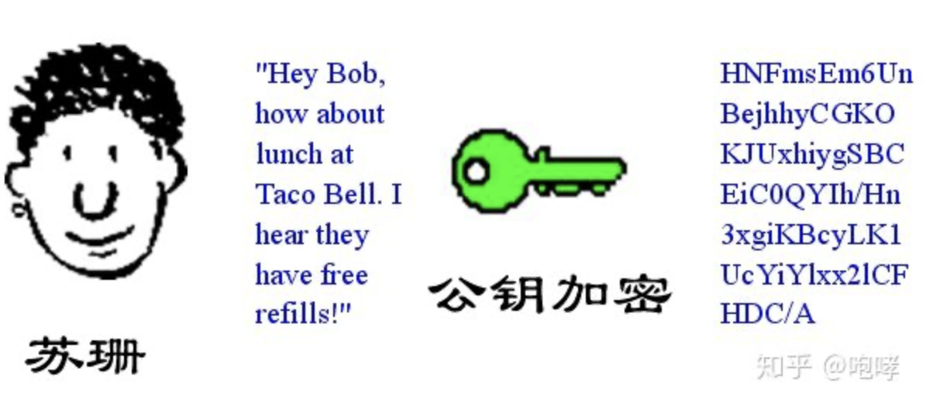
Public-key cryptography, Public-key, and Certificates
1.
2.
Bob’s public key
Everyone has a public key
Bob
Bob’s private key
Patty
Doug
Susan
3.
Encrypt using public key
Susan
Notes:
Vidgenni e

Slide 8
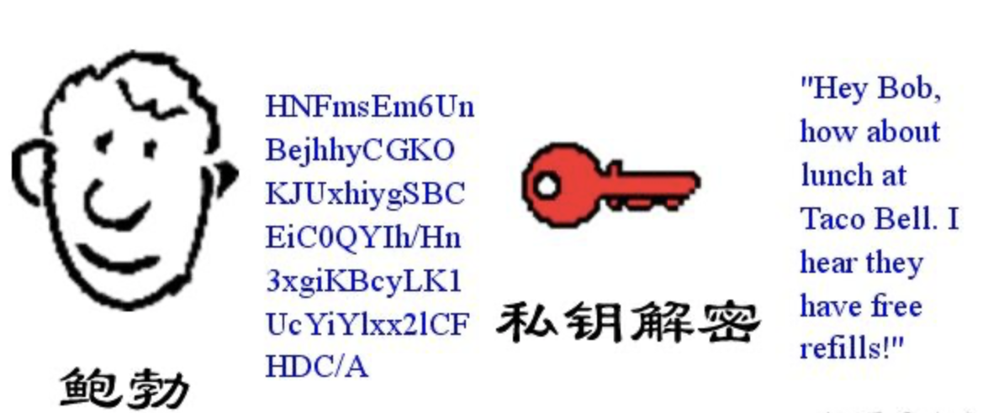
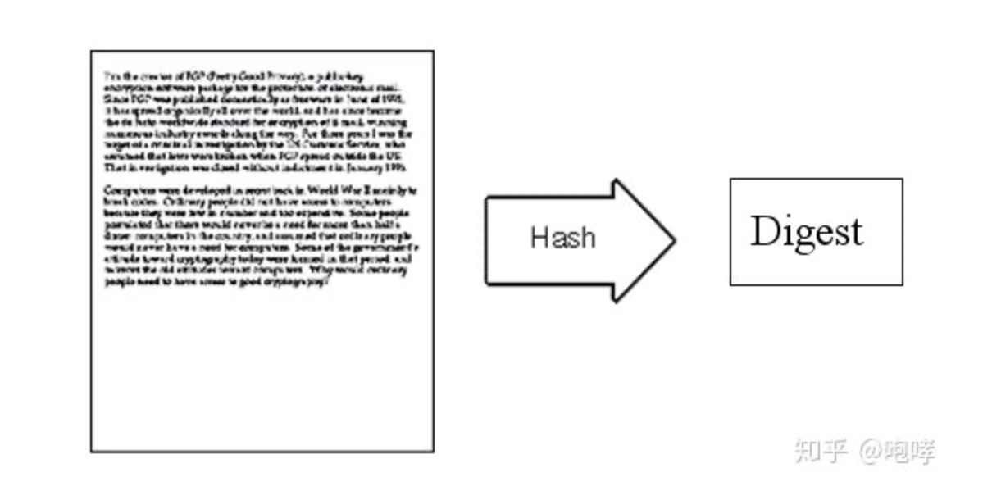
Public-key cryptography, Public-key, and Certificates
Bob wants to reply by ‘digital signature’.
Firstly, using ‘Hash’ function to generate the digest.
4.
5.
Decrypt using private key
Bob
6.
7.
attach
Encrypt using private key
Notes:
Vidgenni e

Slide 9
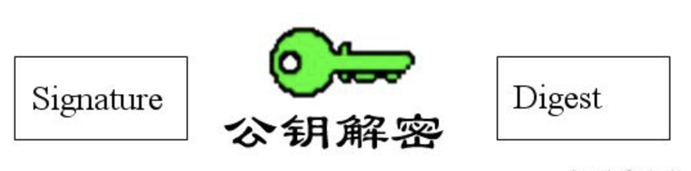
Public-key cryptography, Public-key, and Certificates
Susan uses Hash function to the letter and get a new Digest.
Compare two Digests to see whether the letter used to be modified
8.
Decrypt using public key
Digest belongs to Bob ?
Letter comes from Bob ?
9.
Notes:
Vidgenni e

Slide 10
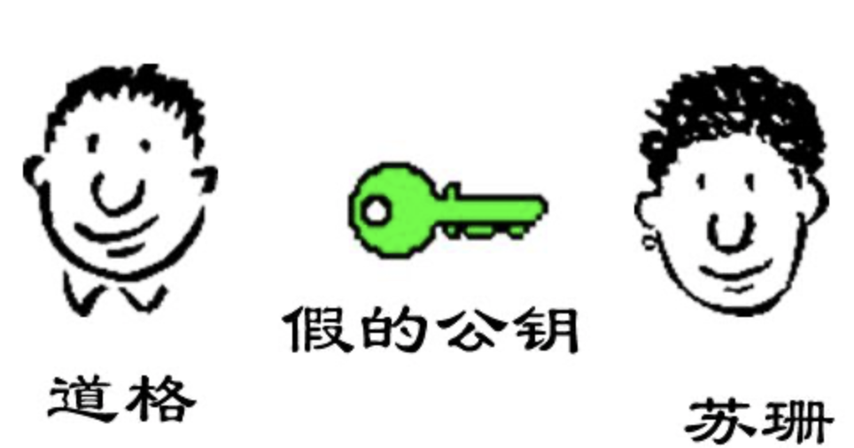
Public-key cryptography, Public-key, and Certificates
10.
Doug uses his private key to do digital signature, and Susan uses false public key to do decryption.
Doug? Bob?
False public key
Doug
Susan
Notes:
Vidgenni e

Slide 11
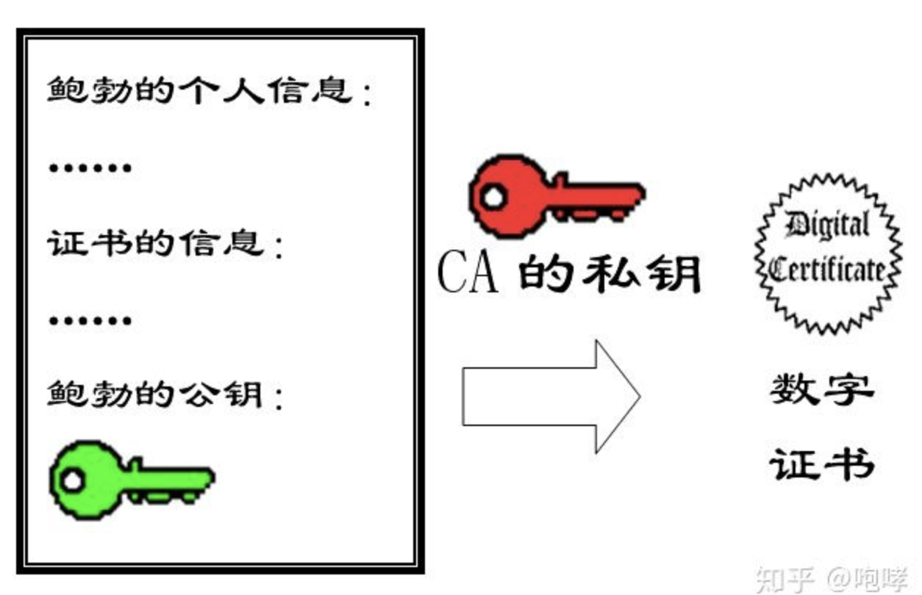
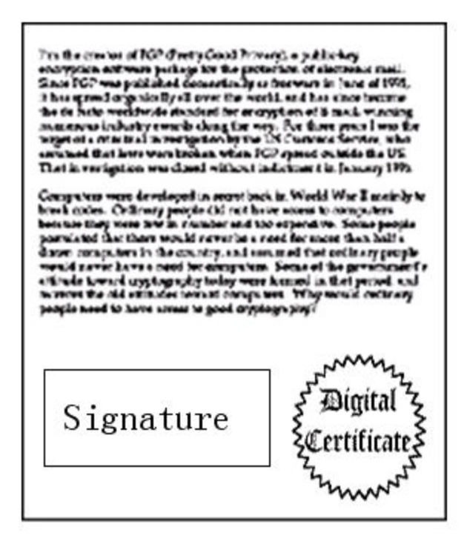
Public-key cryptography, Public-key, and Certificates
11.
12.
Bob’s Information:
Certificate’s Information:
CA’s private key
Bob’s Public Key:
Digital
Certificate
certificate authority (CA):
Do certification for Bob’s public key
Notes:
Vidgenni e

Slide 12
Public-key cryptography, Public-key, and Certificates
11.
CA’s public key
Bob’s Public Key:
Whether the digital signature belongs to Bob ?
Notes:
Vidgenni e

Slide 13
Certificates example: https protocol
For web encrypt:
Client
Server
Server
Client
Notes:
Vidgenni e

Slide 14
Certificates example: https protocol
For web encrypt:
Browser has Credential Manager, which stores all trusted root certificate authority (CA).
Brower can find the public key of decrypting the Certificate according to records of Credential Manager.
If the website recorded by certificate is different from the one you are browsing, this means the certificate maybe illegally used.
Notes:
Vidgenni e

